Slide 1
FAZZA INDO OMAIRA

Slide 2
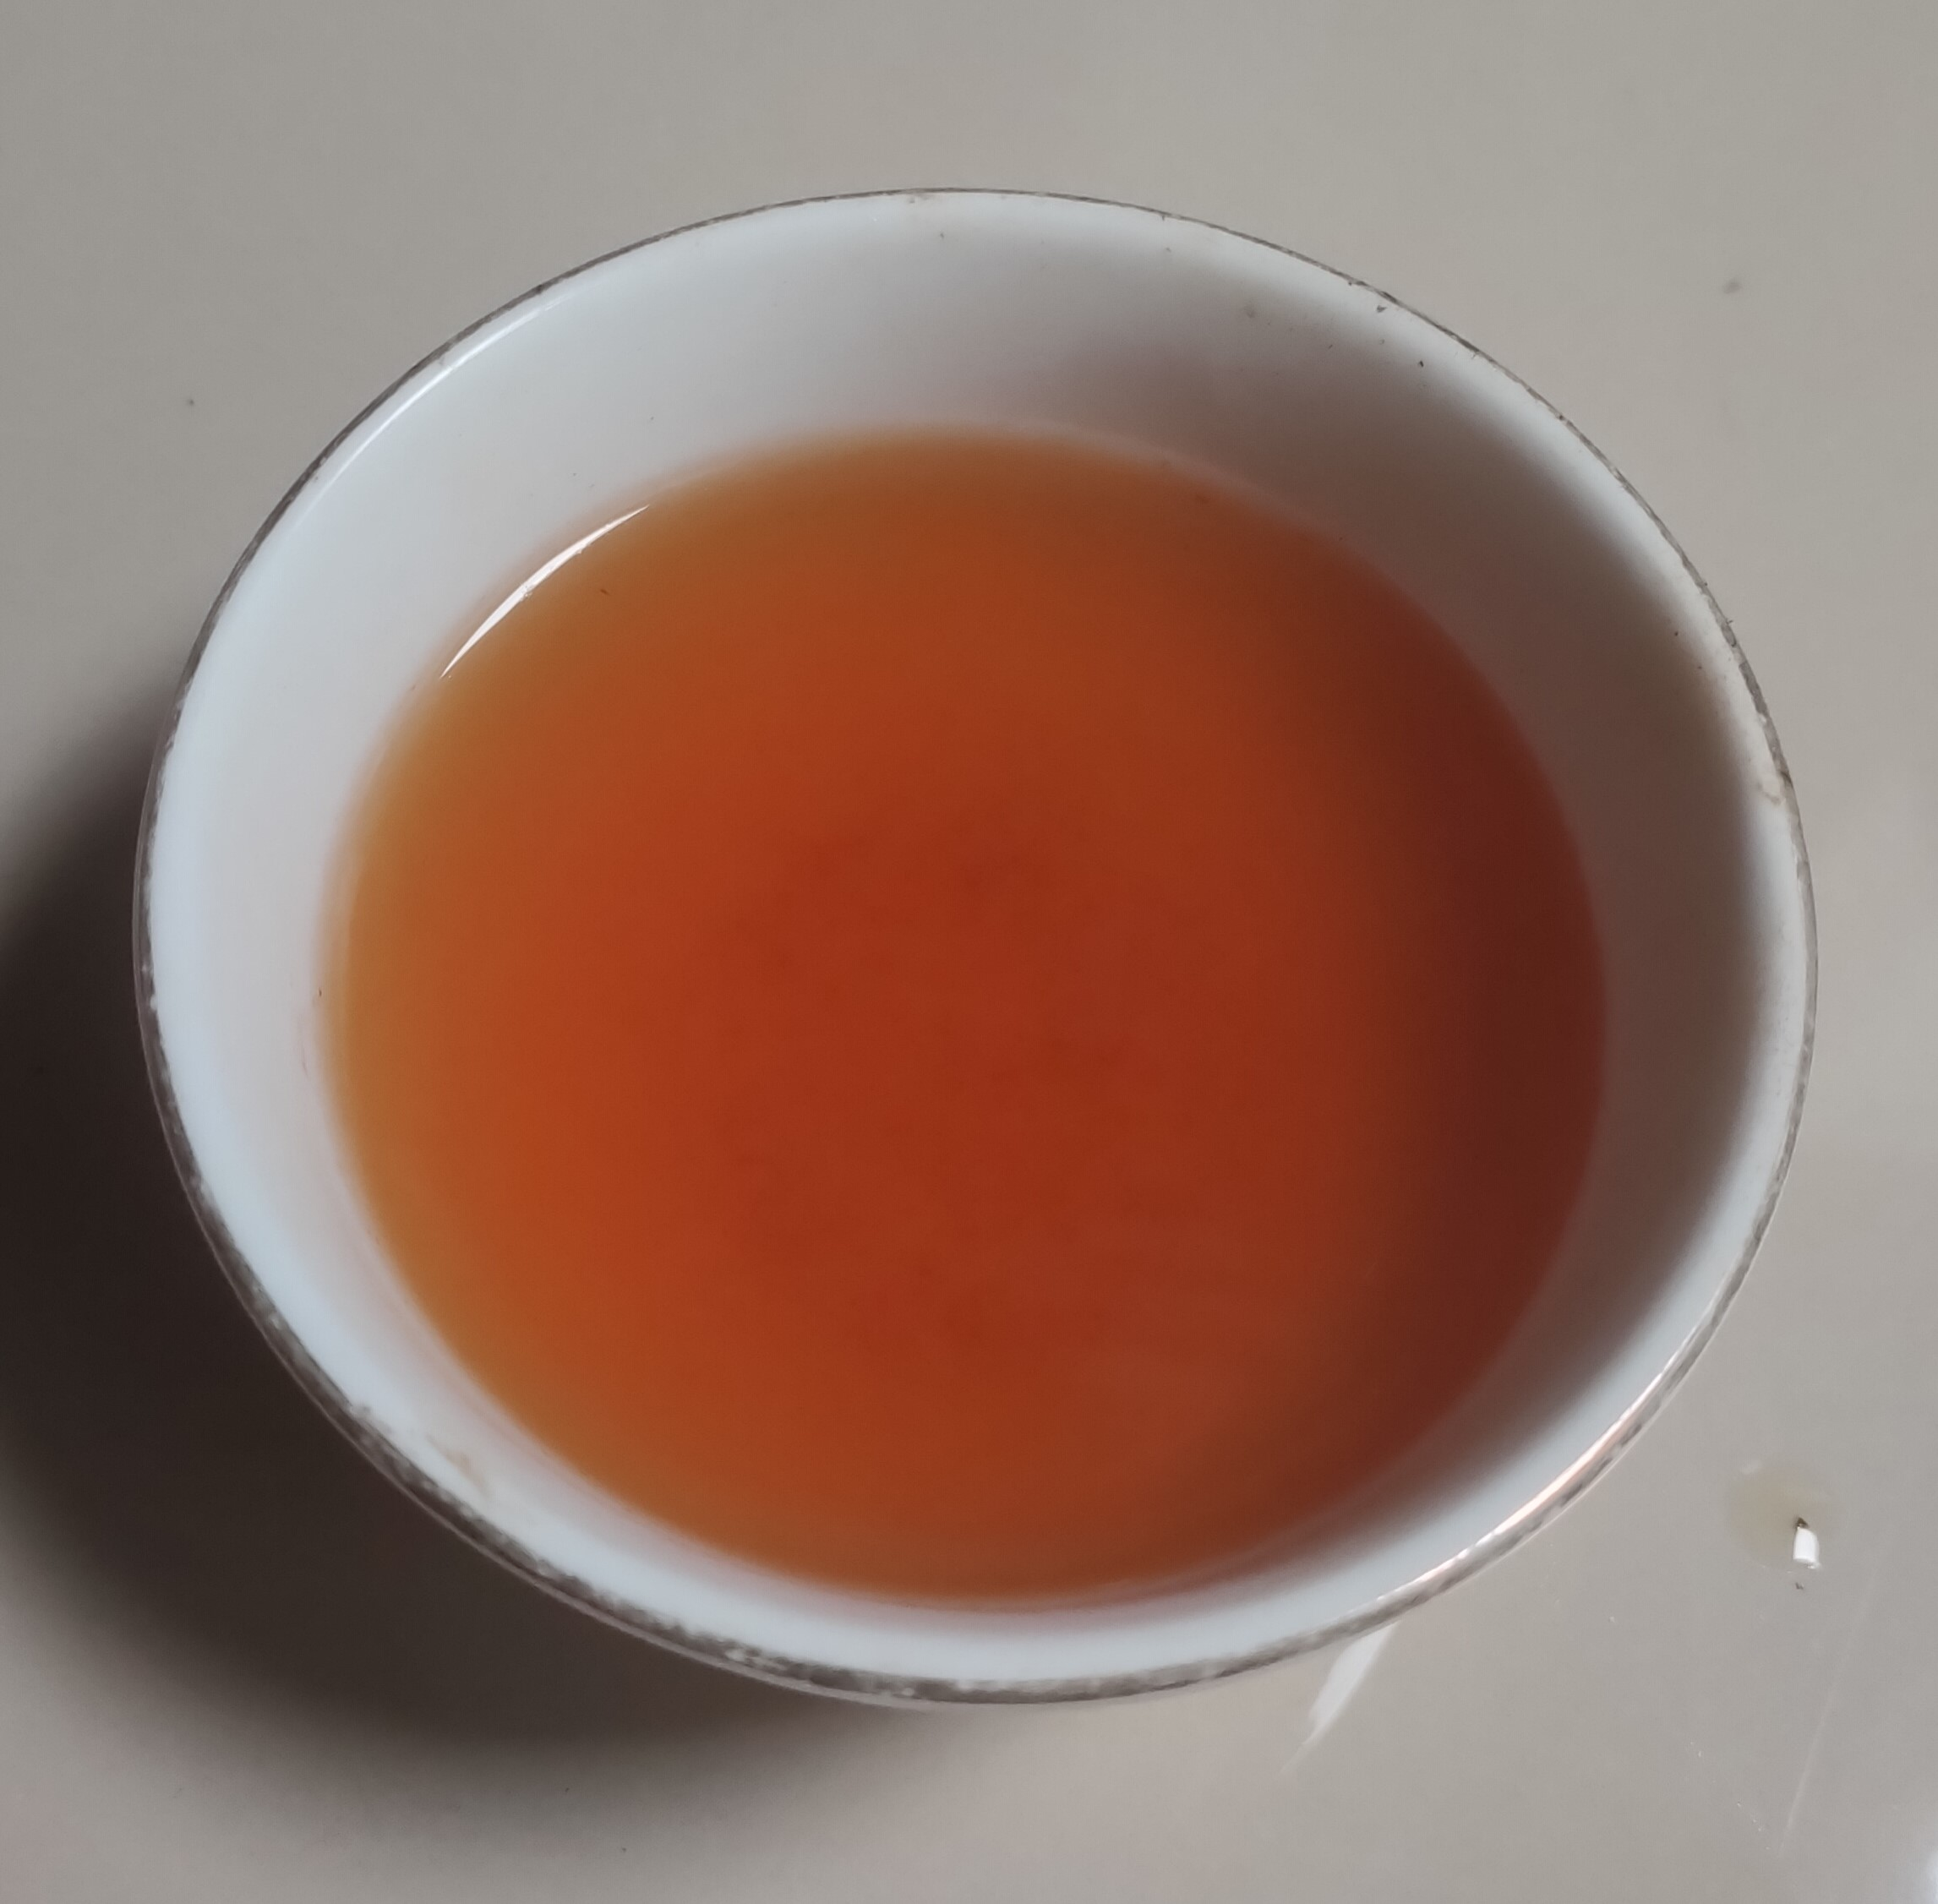
Our vision
Becoming a national company with a global trading reputation, providing the best and most trusted quality.
Our mission
1. Engage in general trade for agricultural and craft products from upstream to downstream, targeting domestic and international markets.
2. Providing high quality products with a focus on customer satisfaction, competitive prices, and ensuring product quality, maximum benefit from the product.
3. Building long-term partnerships by consistently providing the best service.

Slide 3

Origin and production process
Our tea products come from plantations on Mount Dempo, which is famous for its fertile soil and ideal climate for growing high quality tea. The land area at PT Perkebunan Nusantara VII Pagar Alam Unit has a land area of ​​1,722.69 ha and is divided into 5 divisions, namely subdivision I (Talang Darat), afdeling II (Talang Bedug), afdeling III (Estuary Fisheries), afdeling IV (Muara Abad), afdeling V (Mount Agung).
PT. Perkebunan Nusantara VII Pagar Alam Unit is located on the slopes of Mount Dempo at an altitude of 900-1850 meters above sea level, located at 103˚,40',25”-103˚,50',30” E and 4˚,0',15”- 4˚ .3'.45” S. right on Jalan Bejo Kasan no. 10, Gunung Dempo sub-district, Pagar Alam Selatan District, Pagaralam city, Annual rainfall is around 2,500-3,000 mm with humidity reaching around 60%-85% and temperature reaching 16-25 C.

Slide 4
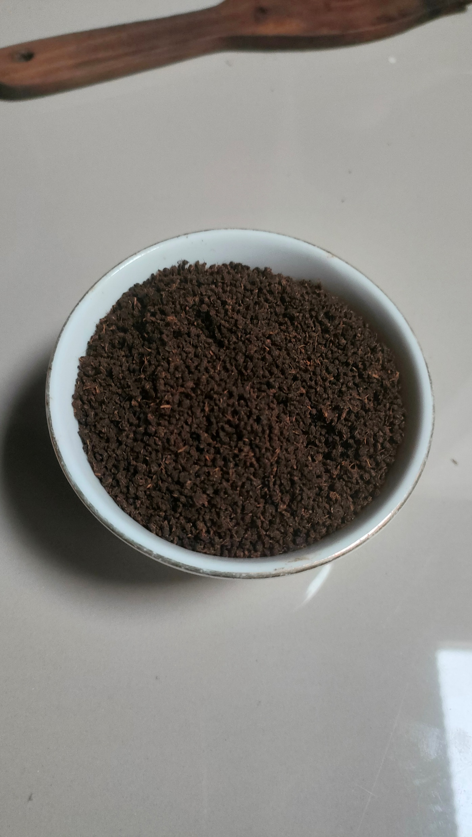
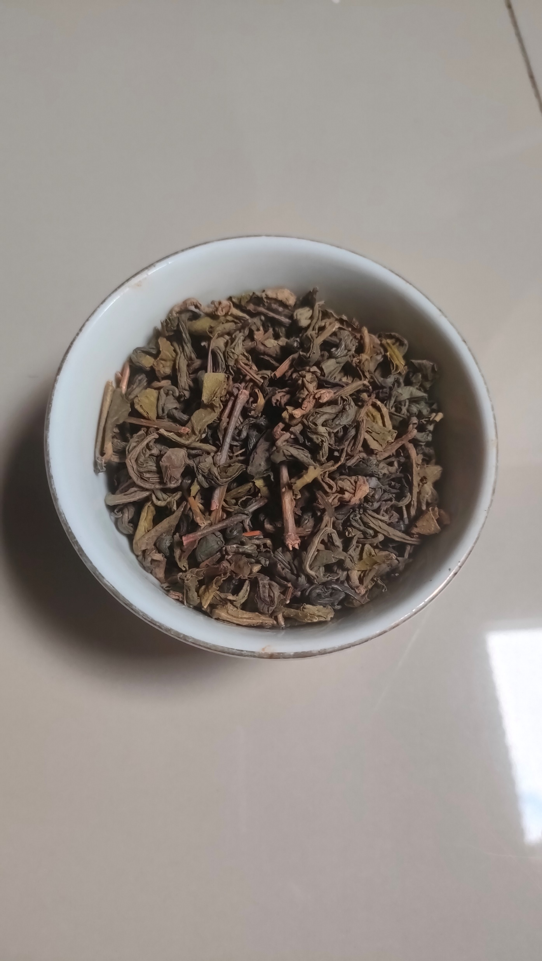
The process of making tea involves rapid withering, so tea leaves with a high water content are not processed properly. Our CTC tea has a rich taste, predominantly giving a strong taste, a combination of astringent and fresh flavors.
The characteristics of green tea, such as color, taste and aroma, are influenced by catechins, flavonoids and amino acids. Catechins provide astringency and freshness, flavonoids contribute to the light green color and brightness, and amino acids such as theanine provide sweetness and umami.

Slide 5
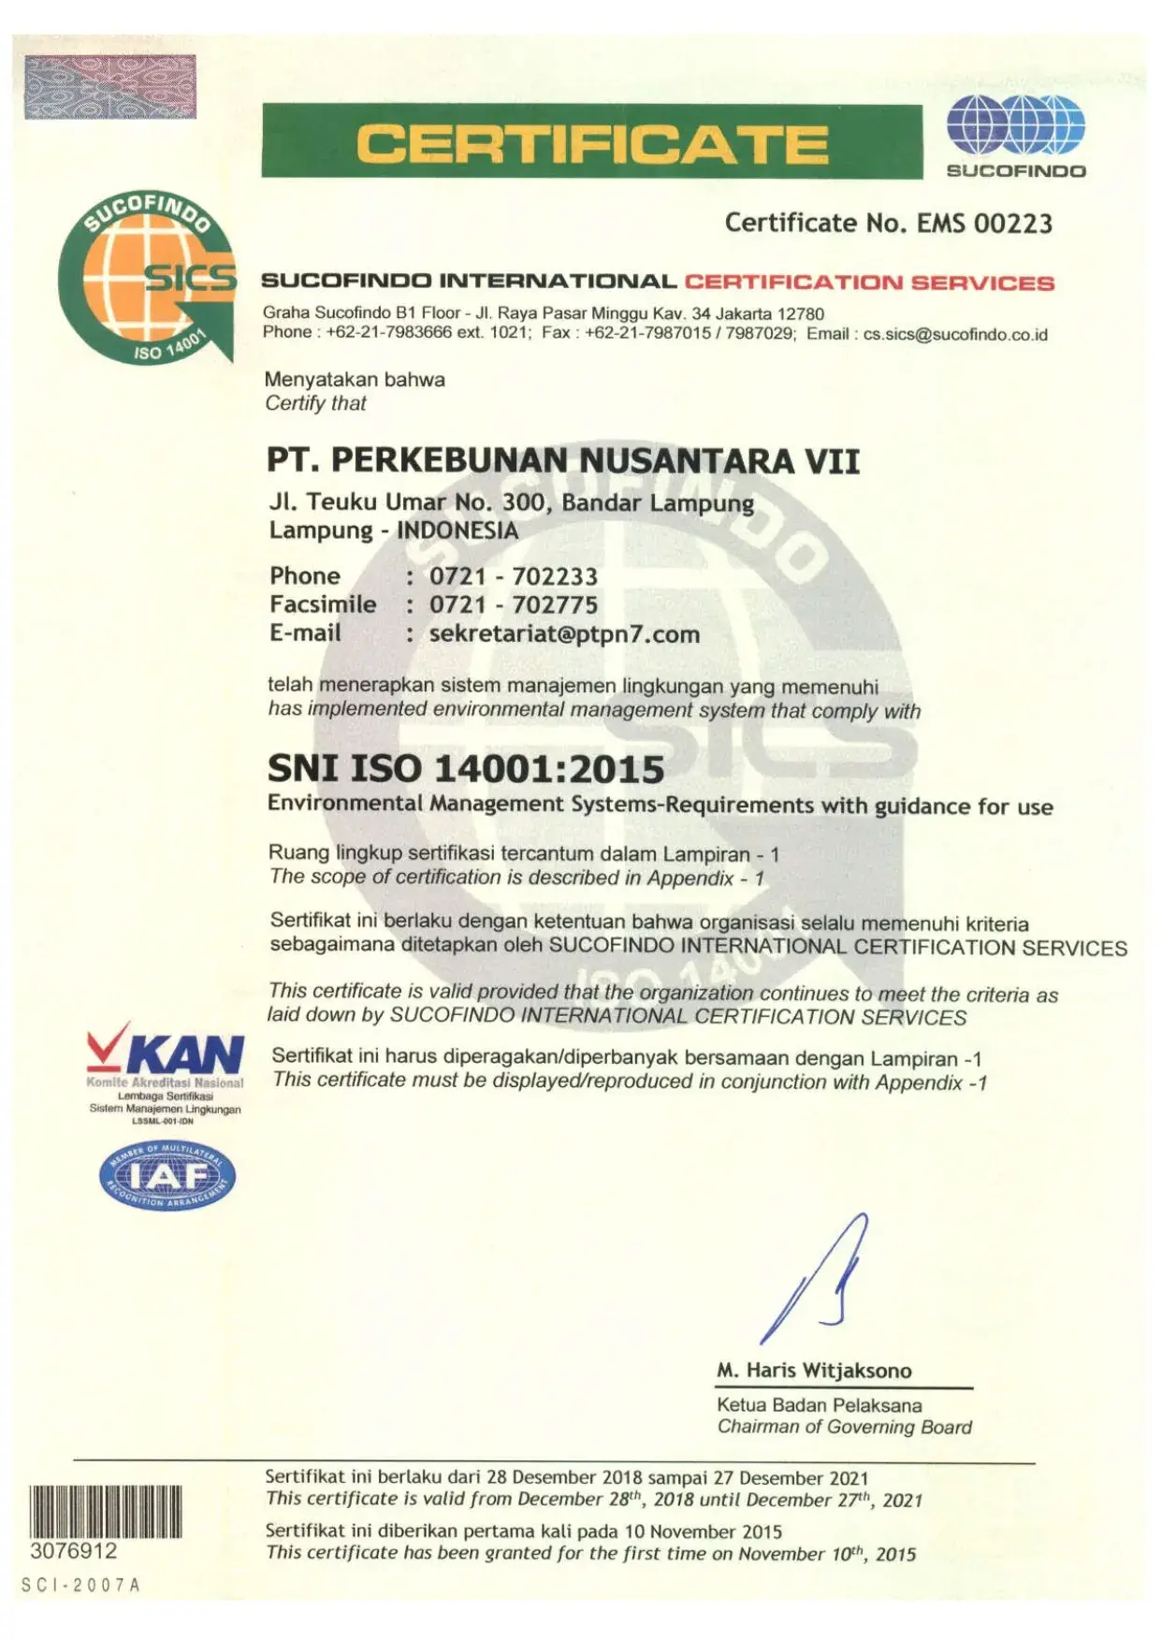
Certification and Security
With ISO 14001 certification, we not only guarantee the quality of our tea, but also ensure that every step in the production process respects and protects the environment in which we operate.
We are proud to announce that our products have domestic halal certification. This certification guarantees that products are produced in accordance with the standards set by the competent authorities in terms of halal, meeting the needs of consumers who are sensitive to religious and halal aspects of food.

Slide 6

Sustainability and Ethics
Our suppliers continue to be committed to implementing responsible and sustainable business practices. Some of the policies and initiatives we implement include:
ISO
14001
WASTE MANAGEMENT
ISO
14001

Slide 7

Supply Stability
Our producers are committed to providing a consistent supply of tea throughout the year. Some of the steps we take to ensure this include:
SAFETY STOCK: Manufacturers always maintain safety stock in warehouses to overcome fluctuations in demand and ensure supply remains smooth.
INVENTORY MANAGEMENT SYSTEM: Our manufacturers use a management system to monitor and manage stock in real-time, so we can respond quickly to market needs.

Slide 8
Composition and Content of Tea
Pure Tea Products:
Black Tea Caffeine Content:
OUR CTC BLACK PRODUCTS have generally higher caffeine content compared to green tea, similar to other black tea products on the market. The caffeine content of black tea ranges from 40-70 mg per cup (240 ml).
CAFFEINE CONTENT: This higher makes black tea a good choice for those looking for an energy boost or substitute for coffee.
THE MAJORITY OF OUR TEA PRODUCTS are pure tea without added ingredients. Our producers focus on the quality of the tea leaves themselves to ensure natural and authentic taste and aroma.
CTC BLACK TEA AND GREEN TEA: our tea products do not contain any additives or mixtures, so customers can enjoy the original taste of tea.
Green Tea Caffeine Content:
- our green tea products have a lower caffeine content than black tea, ranging from 20-45 mg per cup (240 ml). This content is comparable to other green tea products on the market.
- OUR PRODUCT is a good choice for those who want the health benefits of tea with a lower caffeine content.

Slide 9

Commitment to Quality
Selection of Raw Materials
Our producers select high-quality tea leaves from gardens with strict criteria for size, color and maturity.
Controlled Production Process
The standardized and controlled production process includes drying, fermentation, milling and packaging, with strict supervision at every stage.
Testing and Analysis
Each batch of tea is tested to ensure consistency of taste, aroma and overall quality using an in-house laboratory by professionals.

Slide 10

Price and Conditions of Purchase
Minimum Purchase Conditions:
We set minimum purchase quantities to ensure efficiency in production and delivery. For wholesale purchases, the minimum purchase conditions are as follows:
- Small Packaged Tea (100 grams - 500 grams): Minimum purchase of 1000 units per variant.
- Large Packaged Tea (1 kilogram): Minimum purchase of 1000 units per variant unit.
- Tea in Bulk: Minimum purchase of 1000 kilograms per variant.

Slide 11
Price and Conditions of Purchase
Pricing and Payment Policy:
Price:
- Volume Discounts: We offer special discounts for large purchases. Discounts vary depending on order quantity and purchase frequency.
- Competitive Prices: Our prices are very competitive and adjusted to the premium quality of our products as well as our ISO 14001 and Halal standards.
3. Return and Replacement Policy:
- Quality Guarantee: We provide a quality guarantee for all products. If there are problems with product quality, we are ready to replace the goods or refund the money according to the agreement.
- Return Procedure: Product returns can be made within 30 days after receipt, provided the product is still in good condition and has not been opened.
2. Payment:
- Payment Methods: We accept various payment methods, including bank transfer, latter of credit.
- Payment Conditions: Payment is made in two stages:
- Down Payment (DP): Initial payment of 50% of the total order value is made upon order confirmation.
- Repayment: The remaining 50% payment is made before delivery of the goods.
- Limited Credit: For repeat customers with a good purchasing history, we offer credit options with certain terms and conditions.

Slide 12

Packing and Shipping
Inner Packaging: Vacuum Plastic Bag Removes air from the packaging to prevent oxidation and maintain tea quality.
Outer Packaging: Tea packaging for export using outer materials such as high quality paper sack must be designed to withstand shock and pressure during shipping.
Packaging orders
Bulk Packaging: For wholesale customers, we provide packaging in large quantities that is efficient for distribution.
Special Packaging Requests: If you have special needs regarding packaging materials or design, we are ready to work together to fulfill these needs.
- Shipping: We work with trusted shipping services to ensure products arrive on time and in good condition.

Slide 13

Product customization
Co-branding
-We are open to collaboration or co-branding with your local brands. We may explore opportunities to develop joint products or offer our tea products with customized branding.
White Label packaging
- If you have special needs regarding packaging materials or design, we are ready to work together to meet these needs.

Slide 14
Product Sample
Sample Provision:
- We provide tea samples before customers make large purchases. This allows customers to try our products first before making a large purchasing decision.
- The tea samples we provide are generally small, enough for several brews. This gives a good idea of ​​the taste, aroma and quality of our tea.
Sample Delivery Way:
- Tea samples can be sent using courier or express delivery services, depending on your location and available delivery options.
- We work with trusted shipping service providers to ensure samples arrive safely and on time.
Sample Delivery Fee:
- Sample delivery costs are usually borne by the customer. This fee varies depending on the delivery location and service selected (regular or express).
- Sample fees themselves are usually nominal and depend on the type and number of samples requested. We will provide clear information regarding these costs before delivery.
Sample Request Process:
- To get tea samples, you can contact us via email or telephone to make a request. We will guide you through the process and ensure samples are delivered that meet your requirements.

Slide 15

Legality and Compliance
1. International Regulatory Compliance:
- Our products are manufactured and packaged in compliance with strict international standards, including food safety and health requirements applicable in many export destination countries.
- Our products also comply with applicable regulations regarding quality, safety and sanitation standards required for export to various global markets.
2. Product Certification:
- Our products have received various important certifications, including ISO 14001 for environmental management and Halal certification. This certification proves our commitment to quality and compliance with international standards.
Special Permits or Documents for Importing Our Products:
Standard Export Documents
Special Documents on Request
Consult with Legal Experts or Authorities

Slide 16

Transportation and Logistics
Product Delivery Options:
1. Domestic and International Shipping
2. Delivery Service Options
- Express Delivery: Fast service for urgent needs.
- Regular Delivery: Economical and reliable service for non-urgent deliveries.
- Shipping by Container: For large orders, we offer shipping using a secure container.
Maintaining Product Freshness During Long Distance Delivery:
Safe and Protected Packaging: - Special packaging protects tea from moisture, light and air.
Temperature and Humidity Control: - Products are stored and shipped under controlled temperature and humidity conditions.
Strict Handling Procedures: - Strict handling procedures ensure products are handled carefully, including clear labeling and handling instructions.
Shipping Tracking and Monitoring: - Real-time tracking service provides certainty about delivery status. We also monitor shipping conditions to address issues promptly.

Slide 17

PRICING AND NEGOTIATION
Product Price: Our product prices can be negotiated based on purchase volume.
Discounts on Large Purchases: We offer discounts for large purchases. The amount of the discount will be adjusted to the volume and negotiation conditions.

Slide 18

Customer Service
Customer service for the products we provide.
1. Customer Support
: Support via telephone, email or online chat.
Product Information: Complete guide to storing and brewing tea.
2. Product Guarantee
- Quality: High quality products guaranteed.
- Returns: Refund and replacement within 30 days if the product is unopened.
3. Loyalty Program
- Discounts: Exclusive discounts for repeat customers.
- Reward Points: Points that can be exchanged for free or discounted products.

Slide 19

B2B BUSINESS PARTNERS
Partnering with our company in B2B business has several advantages, including:
1. High Quality Products
2. Customer Satisfaction
3. Flexibility and Scalability.
4. Professional Support.
5. Sustainability.

Slide 20

DON’T MISS THIS OPPORTUNITY
We are proud to present the Best Offers for Mount Dempo Tea which is famous for its premium quality and distinctive taste. Here are the reasons why you should choose our products:
1. Guaranteed Quality: Dempo Mountain Tea is produced to high standards, complies with regulations, is ISO 14001 certified and Halal, ensuring a safe and quality product for the global market.
2. Distinctive Taste and Aroma: Grown in the highlands of Mount Dempo, our tea has a unique and consistent taste and aroma.
3. Commitment to Food Safety: We comply with food safety standards and import regulations from export destination countries such as the FDA in the United States and EFSA in the European Union.
4. Sustainability: Our production process is environmentally friendly, supporting sustainable agricultural practices.
5. Exclusive Offers: Enjoy special prices for large purchases as well as full support from our team in the import and distribution process.

